Slide 1
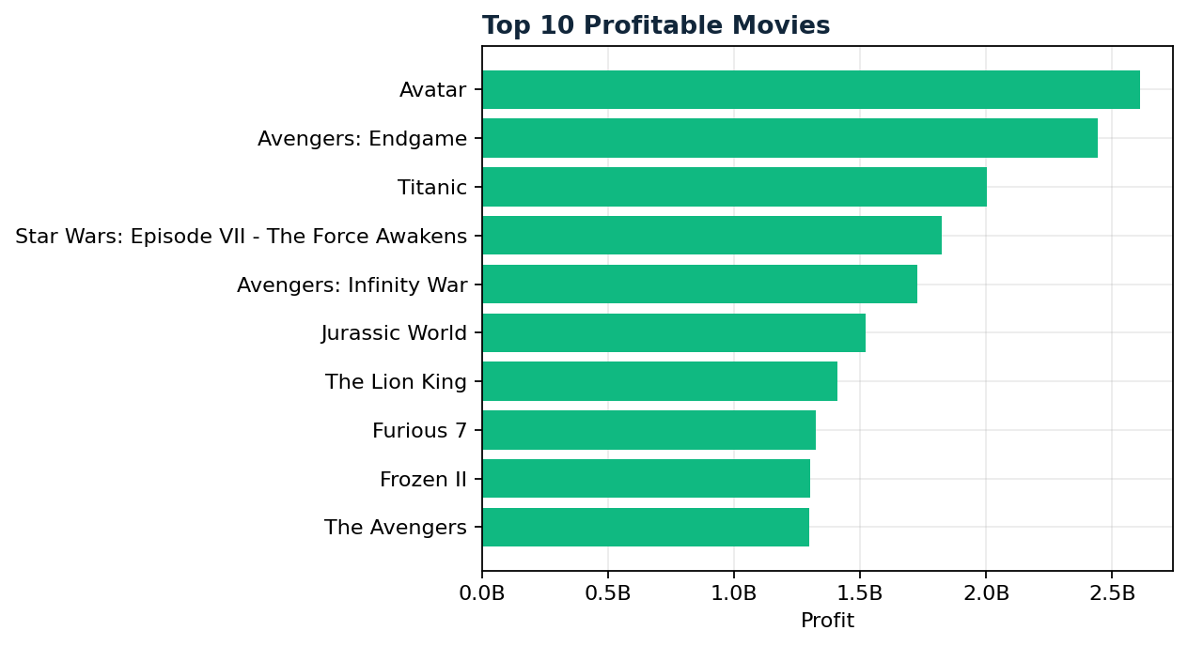
DA02
Complete Final Presentation
CinemaScope Analytics
Business Analytics | SQL ETL | Excel EDA | Power BI | n8n + GenAI
01
02
03
04
05
06
Business
Schema
SQL
Excel
Power BI
Automation
Unveiling the Dynamics of Movie Success
Ashutosh

Slide 2
Executive Presentation Agenda
DA02 | 02
Project Foundation
Analytics and Automation
Business context and problem statement
DBMS architecture concepts
Netflix product dissection and platform solutions
SQL ETL and cleaned movie dataset
Schema design and ER model
Excel EDA and Power BI dashboard insights
Guesstimates, cohort analysis, and A/B testing
n8n + GenAI automation and recommendations

Slide 3
Business Context and Scale
DA02 | 03
Entertainment companies need reliable data to decide what content to fund, promote, recommend, and renew.
Streaming platforms made content consumption more personalized and more competitive
Movie success depends on genre, budget, rating, audience response, star/director impact, and distribution
Analytics helps studios reduce investment risk and identify profitable content patterns
Automation turns dashboards into recurring business summaries and explanations

Slide 4
Problem Statement and Objectives
DA02 | 04
Problem Statement
Project Objectives
Raw movie data is not directly decision-ready
Clean and transform movie data using SQL
High budget does not always mean high ROI
Analyze movie performance through Excel visuals
Business teams need clear insights without manual dashboard review
Build Power BI dashboards for decision-making
Movie performance needs both creative and financial analysis
Automate explanations using n8n and GenAI

Slide 5
Hollywood Insights Dataset Snapshot
DA02 | 05
7,665
1980-2020
19
60
6.39
Cleaned Movies
Year Range
Genres
Countries
Avg IMDb
$587.1B
$364.3B
$25.5M
Total Gross
Total Profit
Avg Budget
Dataset supports performance, profitability, genre, country, rating, star, director, and company analysis
Profitability was created as the main financial decision metric

Slide 6
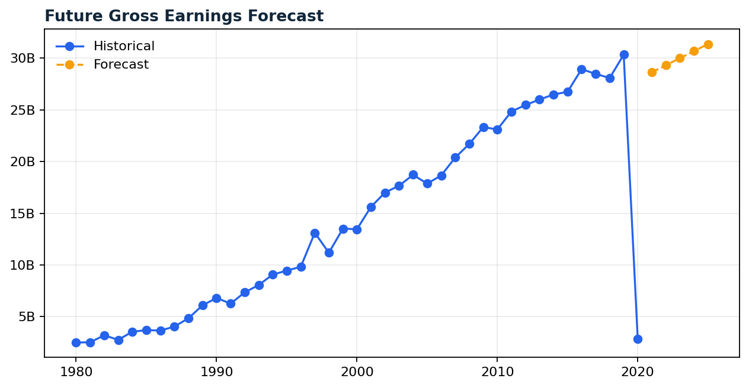
End-to-End Project Workflow
DA02 | 06
01
02
03
04
05
06
Business Case
Schema Design
SQL ETL
Excel EDA
Power BI
n8n + GenAI
Week I: business understanding, schema, guesstimates, A/B testing, and DBMS foundations
Week II: SQL cleaning, Excel analysis, visuals, observations, and recommendations
Week III: Power BI dashboarding and GenAI-powered automation workflows

Slide 7
Business Case Study: Netflix
DA02 | 07
Why Netflix
Business Impact
Global OTT platform for movies, shows, documentaries, anime, and originals
Improves customer retention through recommendation quality
Changed entertainment from fixed schedules to on-demand viewing
Creates brand loyalty through original content
Uses personalization, content depth, and device flexibility to drive engagement
Expands globally through dubbing, subtitles, and regional catalog strategy
Relevant because streaming decisions are heavily data-driven
Uses analytics to guide content acquisition and production decisions

Slide 8
Product Dissection: Features and Engagement
DA02 | 08
Core Features
Engagement Value
Personalized recommendations
Reduces content discovery friction
Netflix Originals and exclusive releases
Increases watch time and repeat usage
Offline downloads and continue watching
Improves convenience across network conditions
Multi-device access and adaptive streaming
Supports global audience growth
Multi-language subtitles and dubbing
Strengthens subscription stickiness

Slide 9
Real-World Problems and Platform Solutions
DA02 | 09
Problems
Netflix Solutions
Limited content access
Anytime online streaming
Fixed TV schedules
On-demand content library
Difficulty finding relevant titles
AI-powered content recommendations
Language and regional barriers
Dubbing, subtitles, and regional originals
High churn after early usage months
Personalized retention campaigns and exclusive releases

Slide 10
Financial Roadmap: 25% Profit Growth Strategy
DA02 | 10
5%
4%
3%
5%
AI recommendations
Ad plan
Sharing controls
Regional content
3%
3%
2%
Cost optimization
Retention
Partnerships
Growth comes from personalization, new price tiers, regional expansion, paid sharing, and lower churn
Profit improves when high-budget content is approved using demand and ROI signals
Roadmap: analytics pilots, rollout, then optimization through dashboard and automation feedback

Slide 11
Schema Design: Streaming Platform Data Model
DA02 | 11
Core Entities
Business Use
Users, profiles, subscriptions, payments
Subscription and payment reporting
Content, genres, people, devices
Recommendation and personalization models
Watch history, ratings, recommendations
Engagement and retention analytics
Plans, regions, and engagement events
Content performance and catalog planning

Slide 12
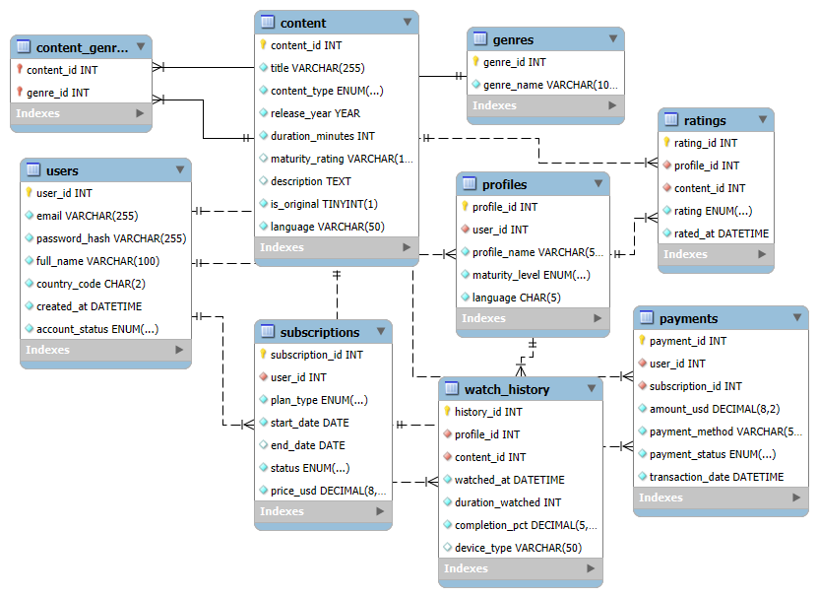
Relational Schema and ER Diagram
DA02 | 12
ER model links user activity, content catalog, subscription revenue, and recommendation outputs
This supports analytics for engagement, billing, retention, and content strategy

Slide 13
Guesstimates: Entertainment Market Outlook
DA02 | 13
Streaming subscription growth: estimated 35% to 45% globally over five years
Digital content consumption in 2025: estimated 20 to 25 hours per person per week
VR/AR entertainment share in next decade: estimated 8% to 12%
New films and TV shows by 2030: estimated 75,000 to 100,000 titles per year
International box office share: estimated 65% to 70% of global revenue

Slide 14
Cohort Analysis and A/B Testing
DA02 | 14
Premium Subscription Cohort
Tutorial A/B Test
Group users by signup month
Version A: text-based tutorial
Track renewal in following months
Version B: interactive guide
Retention = renewed users / original cohort x 100
Metrics: D1/D7 retention, conversion, first purchase, ARPU, LTV
Improve month-3 drop-off using offers, exclusives, and personalization
If B converts better but retains worse, refine and retest

Slide 15
DBMS Concepts: ACID, Indexing, Partitioning, Sharding
DA02 | 15
ACID transactions protect payment, movie-library access, and last-seat reservation integrity
Indexes improve actor, genre, language, title, and description search performance
Partitioning by date and region speeds streaming-log analytics and country reports
Sharding by user_id helps scale global authentication during high-traffic events
Sharding subscriptions by region can create cross-shard reporting and billing complexity

Slide 16
Data Architecture: Lakes, Warehouses, ETL and Governance
DA02 | 16
Raw clickstream and app logs belong in a data lake for flexible storage
Cleaned churn, subscription, payment, and engagement KPIs belong in a warehouse
Live viewing data can stream from apps and smart TVs into dashboards
Weekly box office data can use scheduled batch ETL
Versioning, audit logs, fuzzy matching, and idempotent ETL improve governance

Slide 17
SQL ETL Database Pipeline
PostgreSQL extraction, cleaning, transformation and export
DA02 | 17

Slide 18
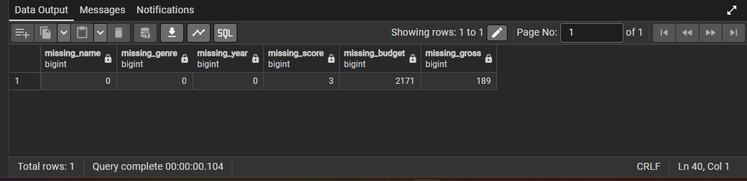
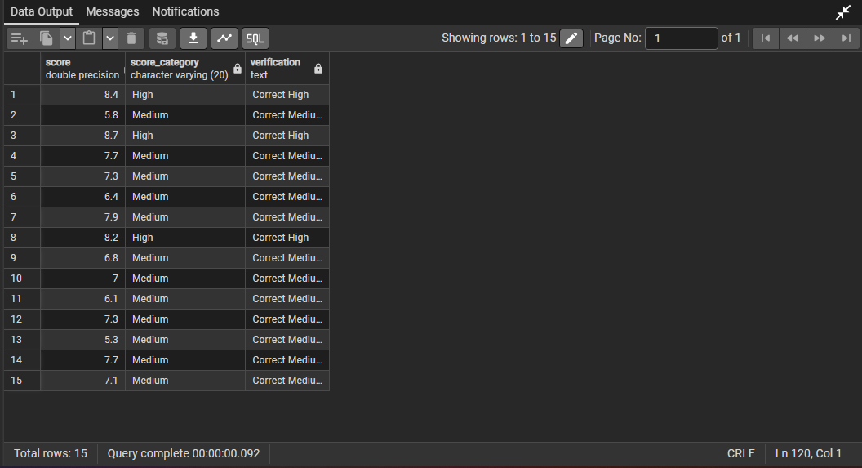
SQL ETL Pipeline
DA02 | 18
01
02
03
04
05
06
Create Table
Import CSV
Missing Check
Transform
Clean Table
Export
Created movies table with 15 fields matching movies.csv
Checked critical missing values and standardized fields
Calculated profitability, score_category, and decade
Missing value output
Created movies_cleaned and exported for Excel and Power BI
Score category validation

Slide 19
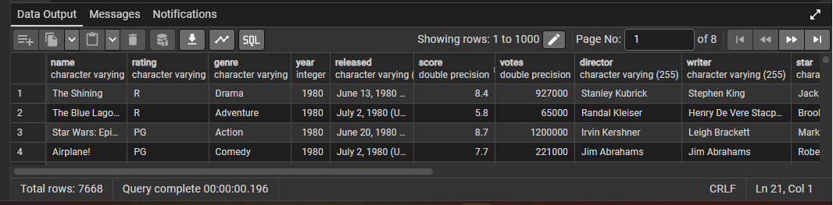
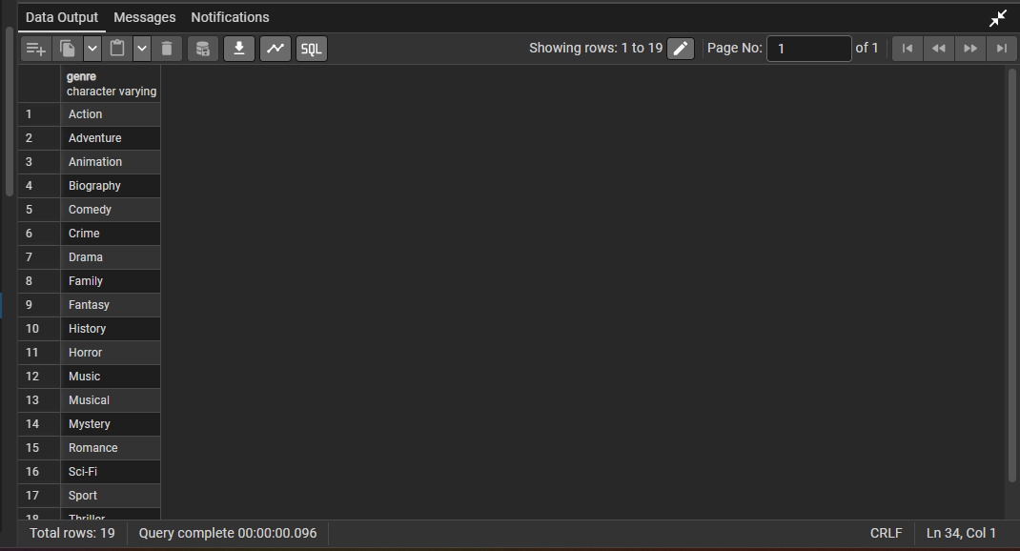
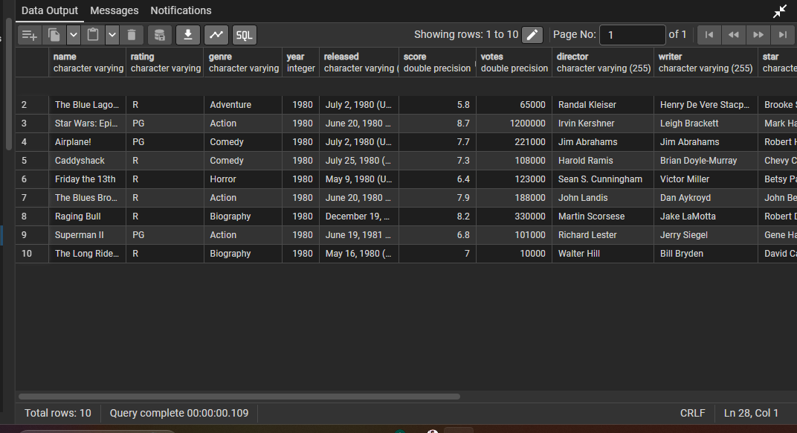
SQL Extraction Evidence
DA02 | 19
Imported data preview: 7,668 rows
Distinct genres
First 10 rows verification
Missing value check

Slide 20
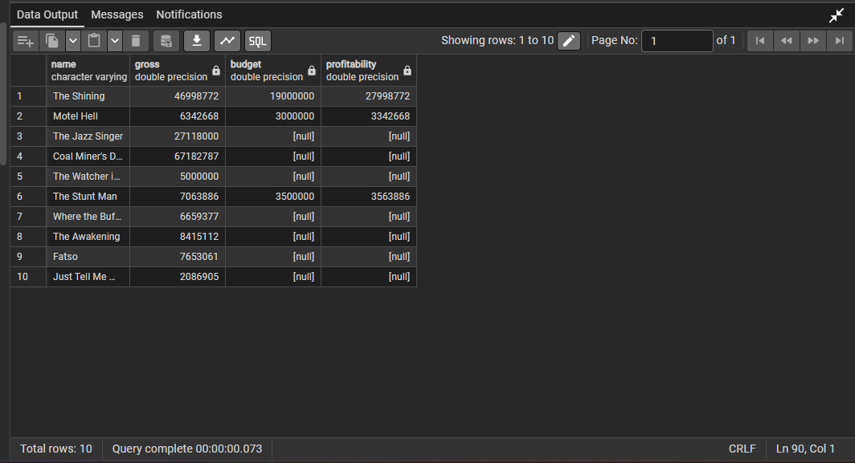
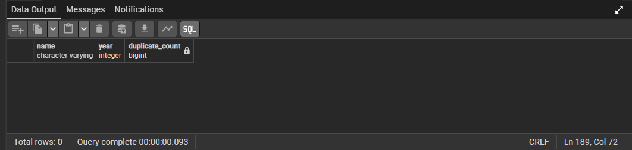
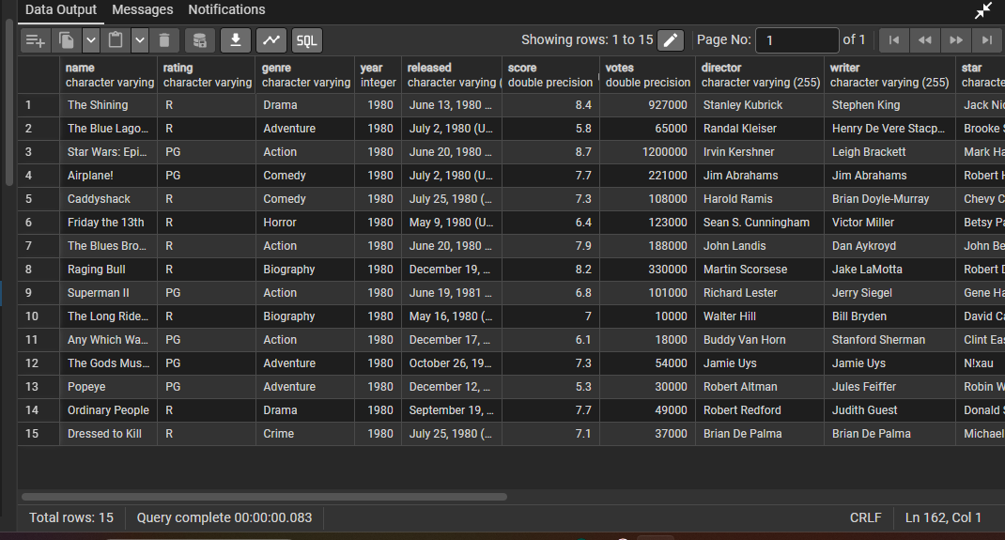
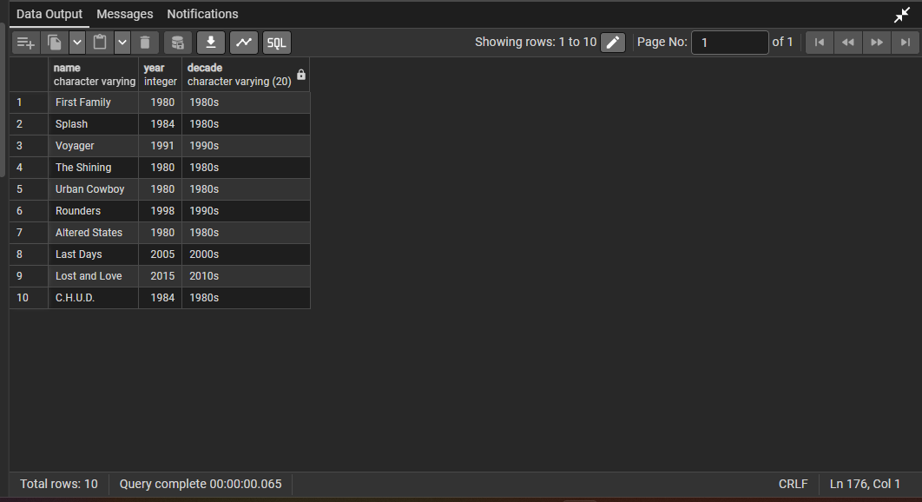
SQL Transformation and Load Evidence
DA02 | 20
Duplicate check: zero duplicate movie/year pairs
Profitability calculation
Decade column
Cleaned table ready for export

Slide 21
Excel and Power BI Analytics
EDA visuals, dashboards and business intelligence
DA02 | 21

Slide 22
Excel EDA Question Coverage
DA02 | 22
Questions 1 to 10
Questions 11 to 20
Missing data handling
High-budget conditional formatting
Sorting and filtering
Star impact analysis
Genre distribution
Profitability calculation
Budget vs gross
Decade-wise analysis
IMDb score categories
Genre pivot table
Country-wise production
Runtime-score correlation
Director analysis
Budget evolution
Runtime analysis
Top companies
Top grossing movies by year
Genre popularity over time
Rating popularity over time
Future gross forecast

Slide 23
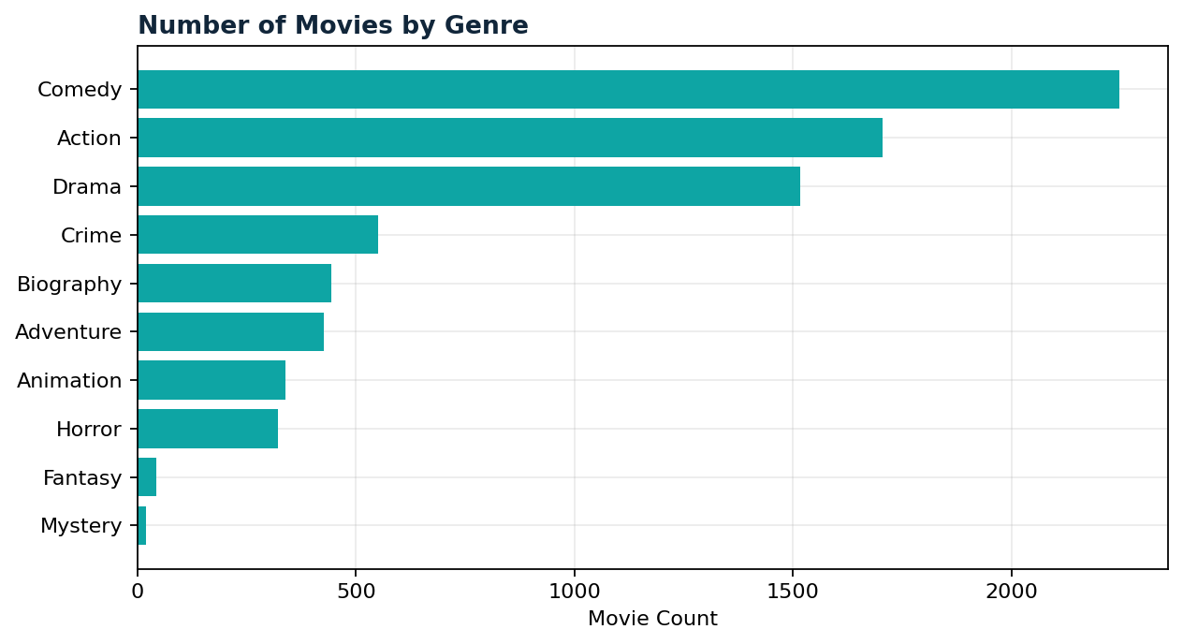
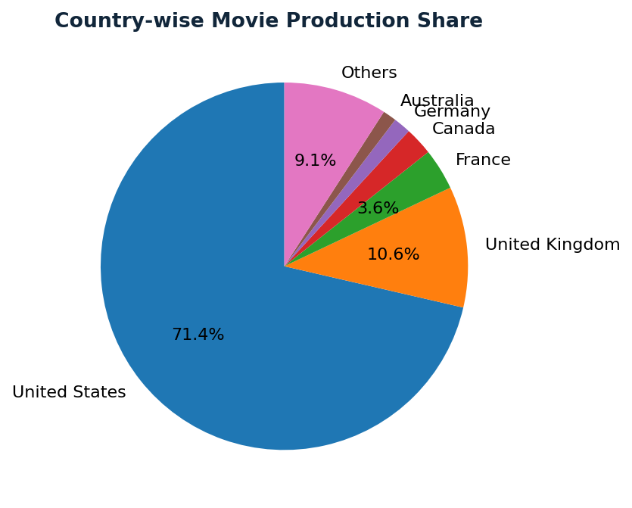
Genre and Country Findings
DA02 | 23
Comedy has the highest movie volume; Action and Drama are also major categories
United States dominates production count, followed by United Kingdom and France
Genre and country mix support portfolio and regional market decisions

Slide 24
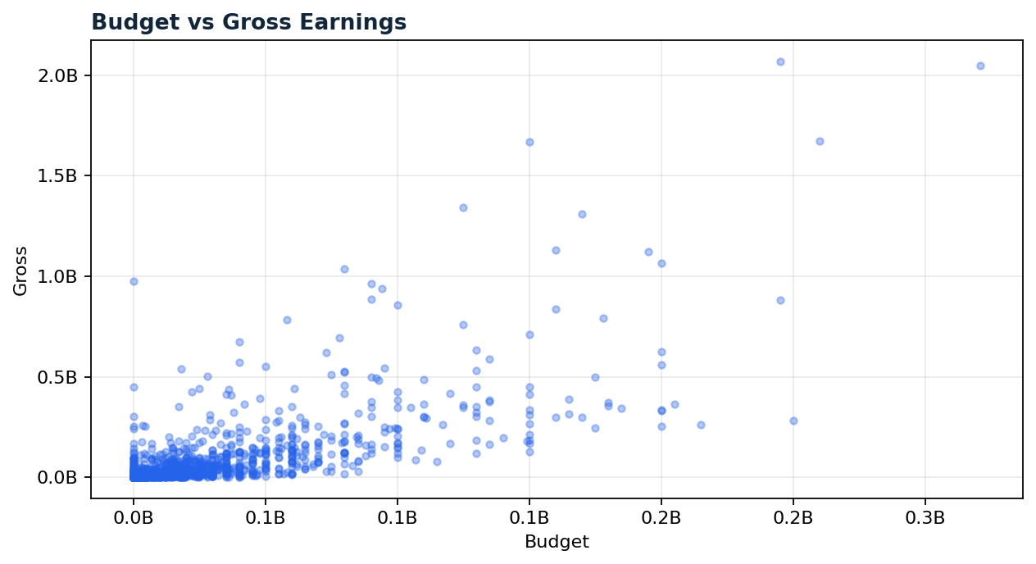
Financial Performance Analysis
DA02 | 24
Budget and gross show a positive relationship, but high budget does not guarantee high revenue
Top profitable movies show the value of franchise strength and strong audience demand
Profitability is more useful than gross alone because it includes production cost

Slide 25
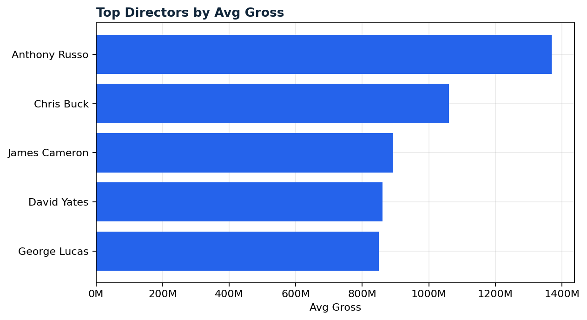
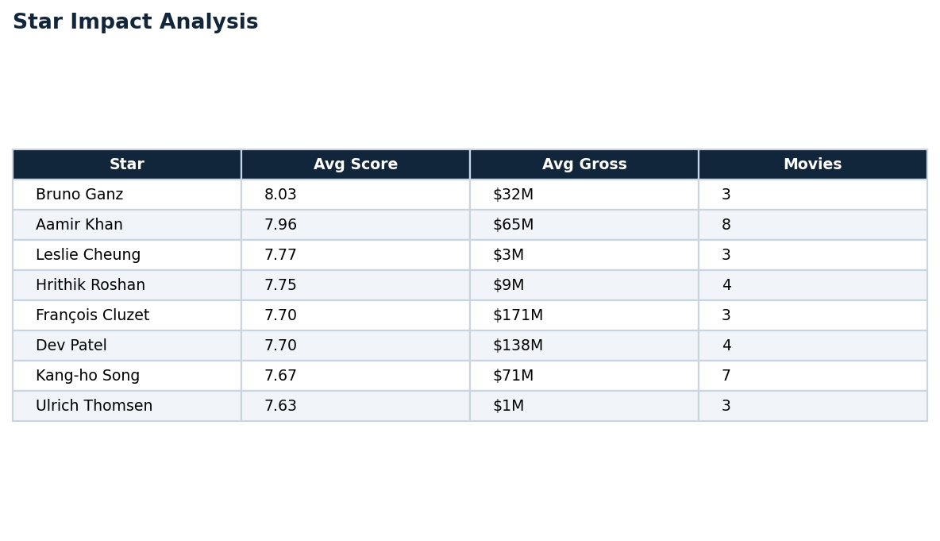
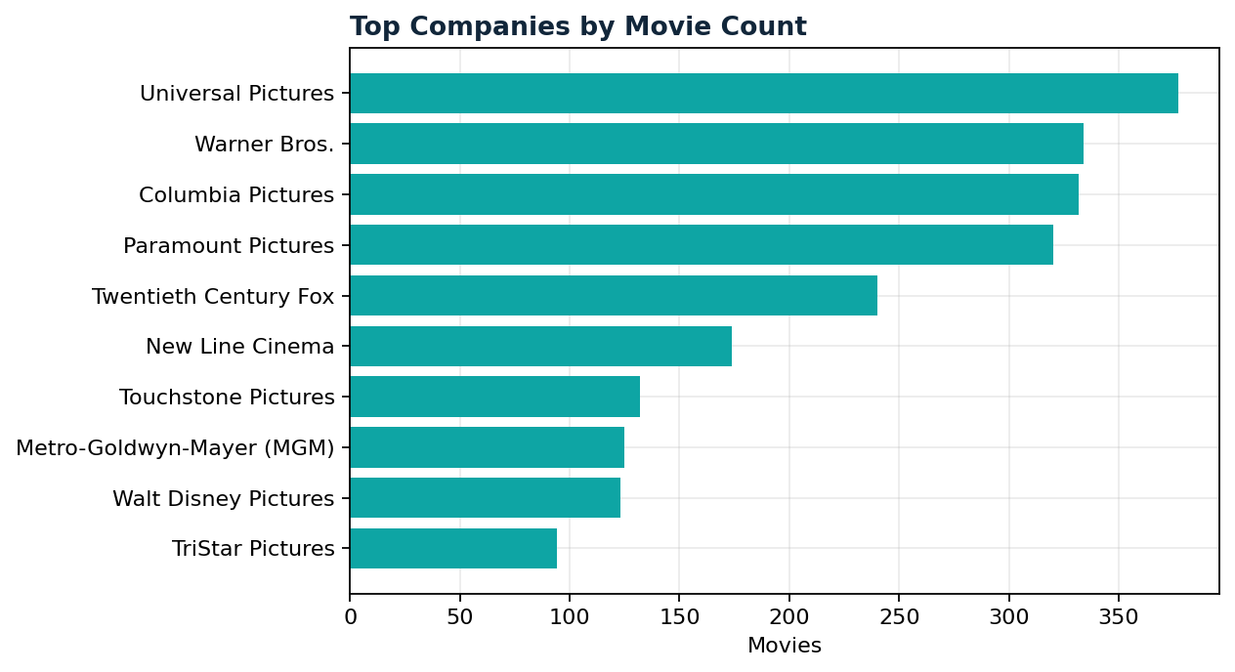
Director, Star, Runtime and Company Analysis
DA02 | 25
Director history helps estimate commercial consistency
Star performance should be read with genre, director and franchise context
High-volume studios benefit from distribution strength and repeat production systems

Slide 26
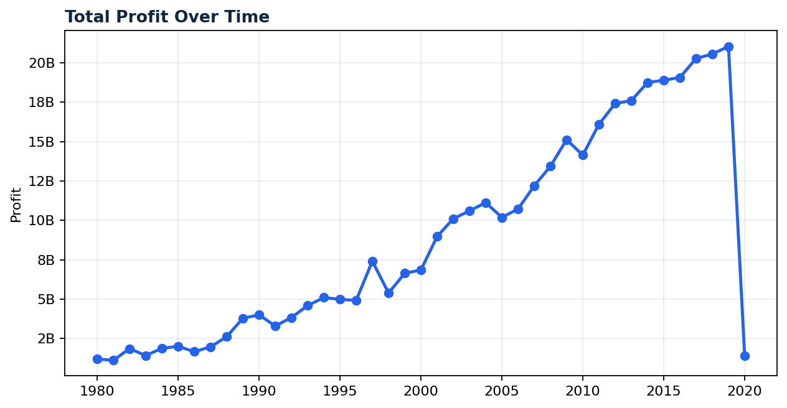
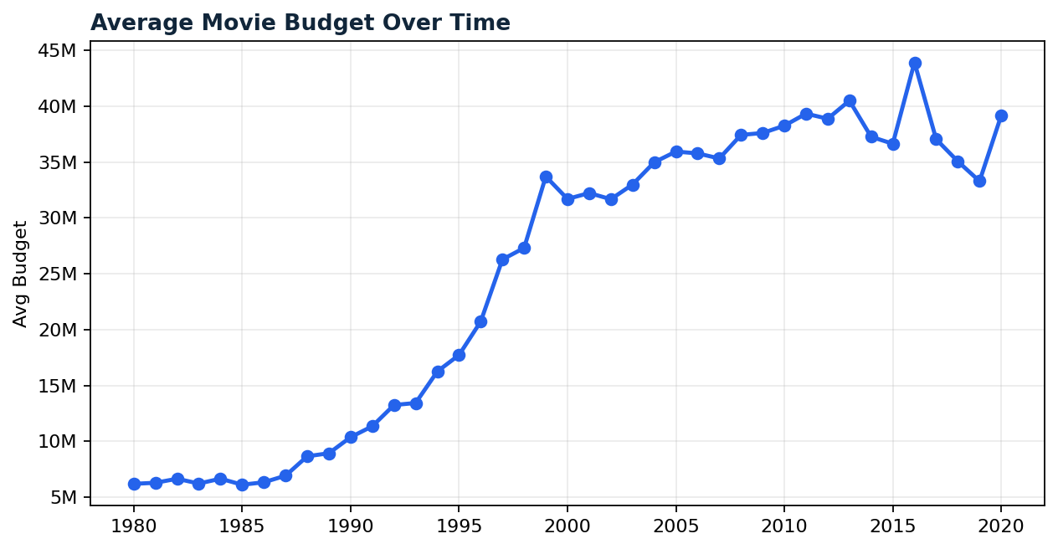
Trend and Forecast Analysis
DA02 | 26
Profit and budget trend upward over time due to bigger markets and premium production
Forecasting is directional and should be combined with genre, score, budget and release strategy

Slide 27
Key Insights and Observations
DA02 | 27
Action
Comedy
United States
6.39
Strongest Profit Genre
Highest Movie Volume
Market Leader
Avg IMDb Score
Action produces the highest total profitability and is a strong investment category
Comedy has the largest content volume, but volume does not always equal profit
Budget and gross are related, yet audience response and franchise strength decide ROI
US production dominates; regional expansion can diversify audience growth
Runtime alone does not strongly explain IMDb score

Slide 28
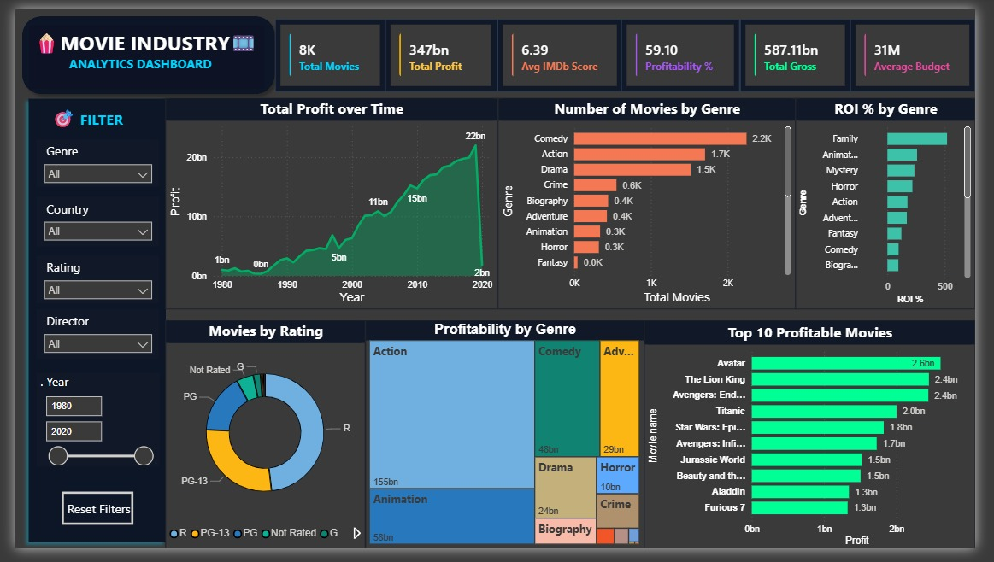
Power BI Dashboard Page 1: Overall Dashboard
DA02 | 28
Key Business Insights
Strong financial scale: $587.11bn gross and $347bn profit with 59.10% profitability.
Action leads profit with about $155bn, while Comedy leads volume with nearly 2.2K movies.
Top profitable movies are franchise/event titles such as Avatar, Avengers, Titanic and Star Wars.
ROI by genre highlights Family as a high-return segment, useful for lower-risk investment.
Profit rose strongly over time, but the 2020 drop shows market disruption risk.
Overall dashboard shows that genre-level ROI and franchise strength should guide budget allocation, not movie count alone.

Slide 29
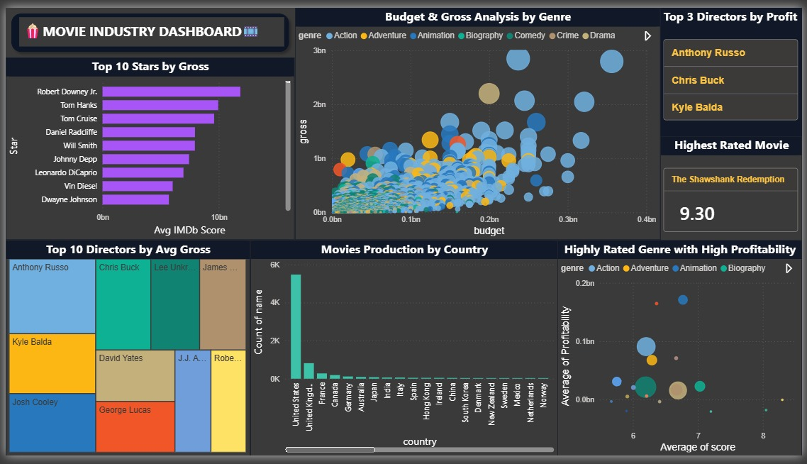
Power BI Dashboard Page 2: Key Analysis
DA02 | 29
Key Business Insights
Robert Downey Jr., Tom Hanks and Tom Cruise appear among strong gross-generating stars.
Anthony Russo, Chris Buck and Kyle Balda stand out among top directors by profit.
Budget vs gross scatter shows positive relation, but outliers prove high budget is not enough.
United States dominates production count, indicating strong Hollywood concentration.
Highly rated and highly profitable genres help identify quality-plus-profit investment areas.
Key analysis dashboard supports casting, director selection, country focus and genre investment decisions.

Slide 30
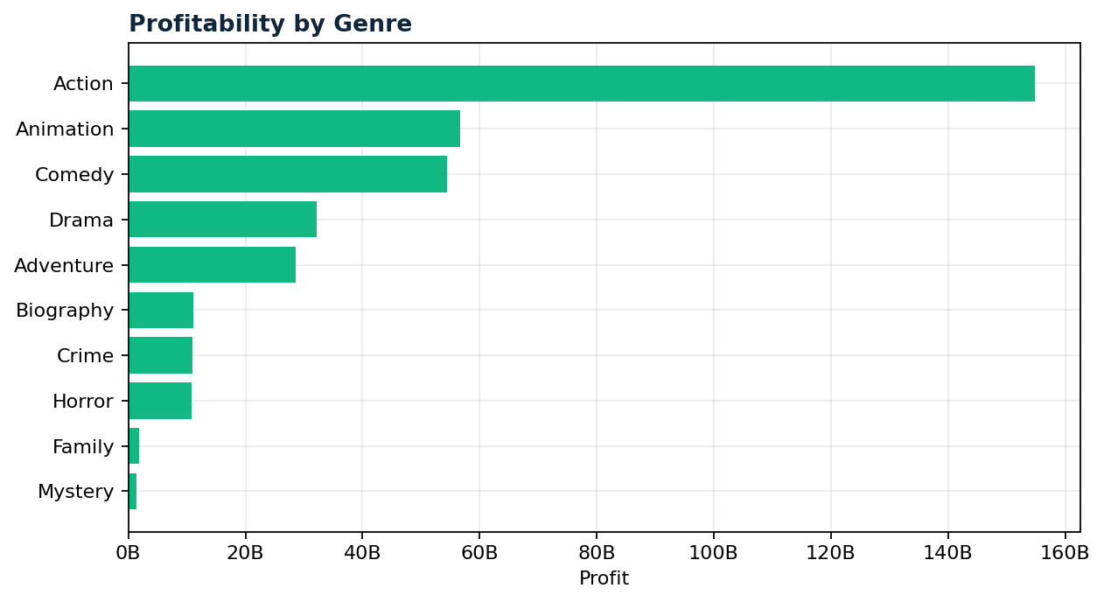
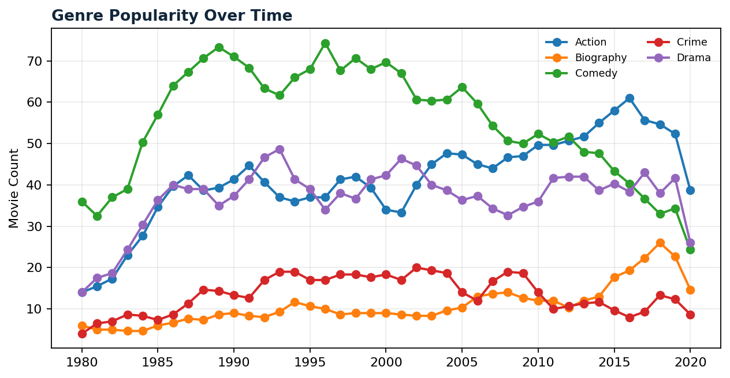
Power BI Dashboard Business Insights
DA02 | 30
Action is the highest profit genre with about $155B profit
Comedy leads movie volume, proving that volume and profit are different decisions
Profit trend rises strongly before the 2020 disruption
Budget-gross visuals help identify overinvestment and high-return outliers

Slide 31
n8n Automation and GenAI
Automated insight delivery and AI explanations
DA02 | 31

Slide 32
Workflow 1: Movie Performance Insight Generator
DA02 | 32
01
02
03
04
05
Schedule Trigger
Sheets Reader
KPI Formatter
GenAI Request
Email Report
Input: Weekly and previous 18-month movie performance KPIs (gross revenue, profitability, ratings, and release volume)
Prompt: Compare a given week's movie performance against the previous 18 months of market benchmarks
Output: AI-generated executive summary with release environment assessment and performance insights
Business value: decision-makers get insights and weekly comparison without opening the dashboard daily

Slide 33
Workflow 2: AI Movie Recommendation Explanation
DA02 | 33
01
02
03
04
5
Webhook Node
Basic LLM Chain
Google Gemini Chat Model
Respond to Webhook
Input: user question such as why a movie underperformed or which genre gives best ROI
Data fetched: budget, gross, genre, IMDb score, votes and runtime
Prompt: explain performance and compare with similar movies
Output: data-backed explanation and action recommendation

Slide 34
GitHub Repository and GenAI Requirements
DA02 | 34
Repository Must Include
GenAI Usage
n8n workflow JSON exports
Input: structured KPI/movie data
README.md with problem statement
Prompt: summarize, explain and recommend
Workflow step explanation
Output: business-readable insight text
Screenshots and sample outputs
Security: use credentials, never hard-code API keys

Slide 35
Executive Action Recommendations
DA02 | 35
Prioritize Action, Animation and proven franchise films for high-budget investment
Use IMDb score, votes, genre, star, director and budget benchmarks before approving major releases
Control risk by comparing expected ROI with genre-level performance patterns
Expand regional content in high-growth markets to diversify audience reach
Automate weekly performance summaries using n8n and GenAI

Slide 36
Implementation Roadmap and Reflection
DA02 | 36
Roadmap
Learning Outcomes
0-3 months: validate KPIs, clean data, automate weekly summaries
End-to-end analytics workflow practice
3-6 months: refine dashboard filters and GenAI explanations
SQL cleaning and Excel visualization discipline
6-12 months: scale content ROI forecasting and regional insights
Power BI storytelling for business decisions
Ongoing: monitor churn, ROI and content demand signals
Automation mindset using n8n and GenAI

Slide 37
THANK YOU
DA02: CinemaScope Analytics - Unveiling the Dynamics of Movie Success

